Slide 1
PARCC
Student Presentation

Slide 2
Student Skills for Online Test
Test Navigation
Click and highlight (Select)
Drop-down selection
Drag and Drop Answers
Typed Responses (Open Ended)
Multiple Choice Select
Changing answers
Two Part questions

Slide 3
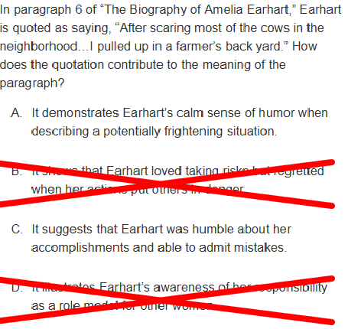
Assessment Tools
Change background/foreground colors
Line Reader
Magnifier
Hide/Mask Answers
Answer Eliminator
Ruler/Protractor
Math Symbols
Flag questions for review
Review marked items
Editor Toolbar

Slide 4
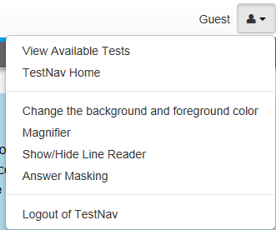
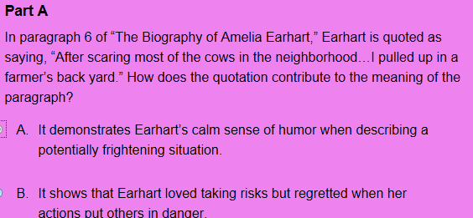
Assessment Tools
Previous or next test page
Flag – to Review test question later
Used to eliminate answers

Slide 5
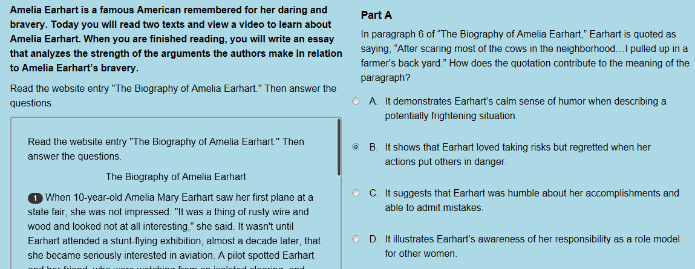
Reading the Questions
Multiple Choice Items
Numbered Paragraphs
Use the scroll bar to view entire passage

Slide 6
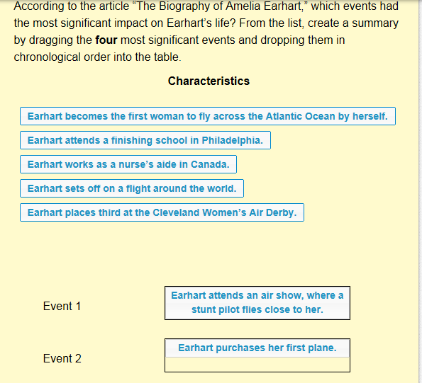
Tips for Reading the Questions
Read each question CAREFULLY
What is the question asking you to answer
Does the answer require multiple responses or more than one task

Slide 7
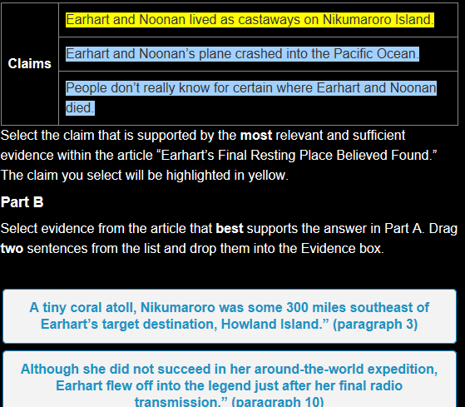
More Question Types
Questions can be based on:
Narrative (text)
Video/Audio
Images

Slide 8
Tips for Completing Open-ended Questions
Pre-write
Type using formal writing techniques
Complete sentences
Use formal language not texting language
Check punctuation and grammar
Spell check – Auto correct NOT built into PARCC
Use editing tools where appropriate

Slide 9
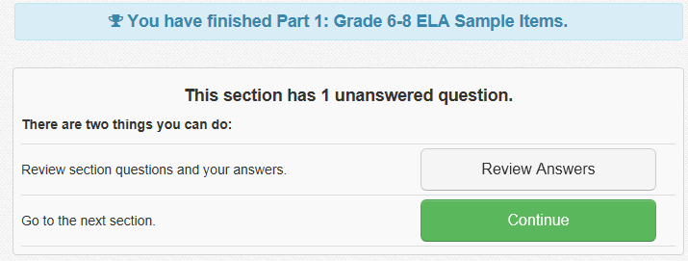
Check test for completion before turning in!!

Slide 10
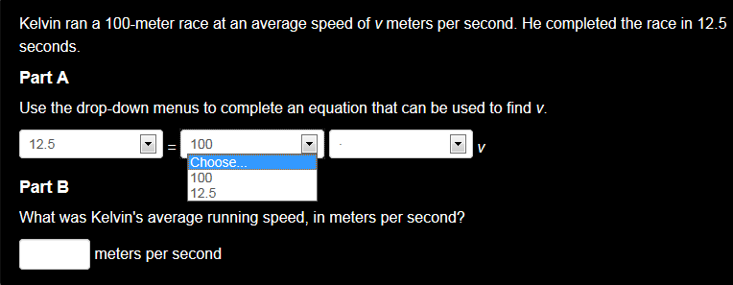
Drop-down Boxes and Math Tools

Slide 11
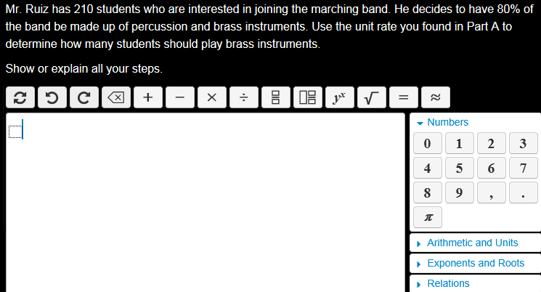
Sample Open-ended Math Item

Slide 12
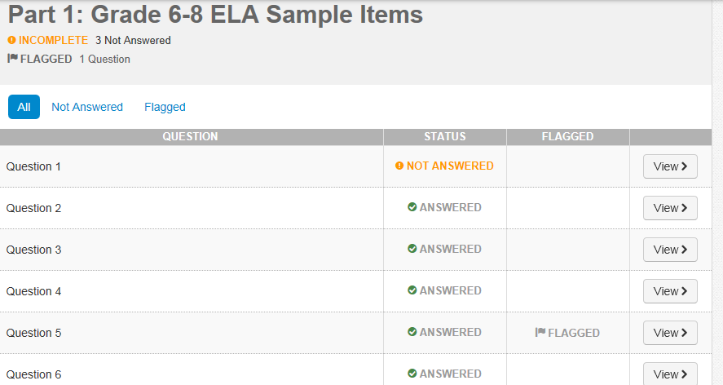
Incomplete items are NOT Flagged!
Review Your Test!!

